Slide 1

RideShare: It’s nice to share!
A program of the Thomas Jefferson Planning District Commission in cooperation with the Central Shenandoah Planning District Commission

Slide 2
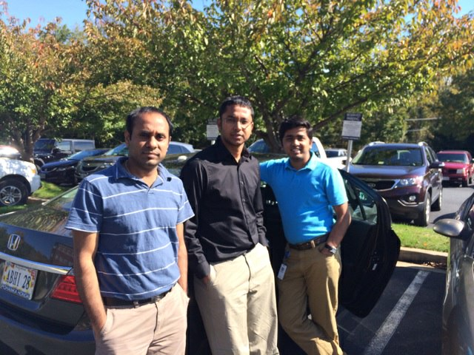
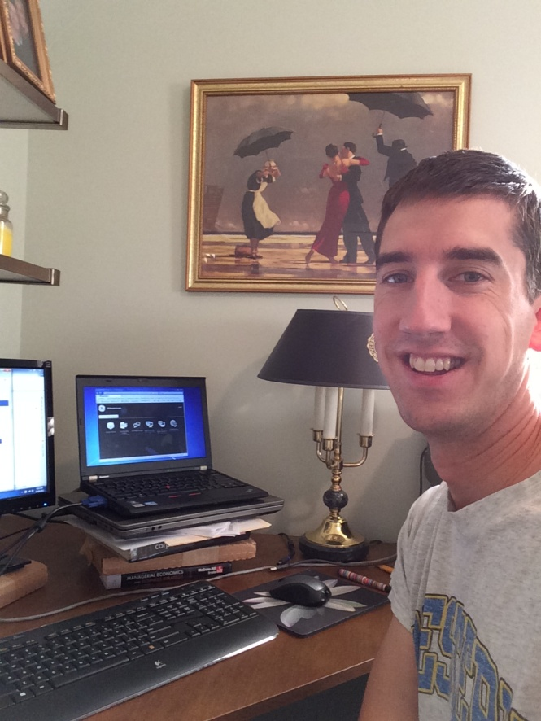
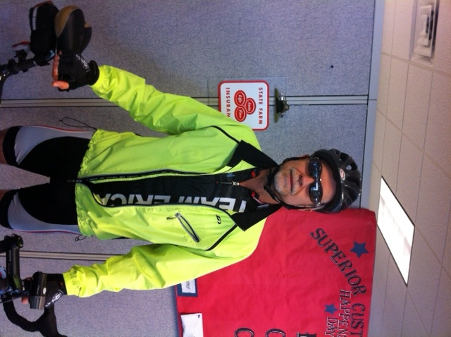
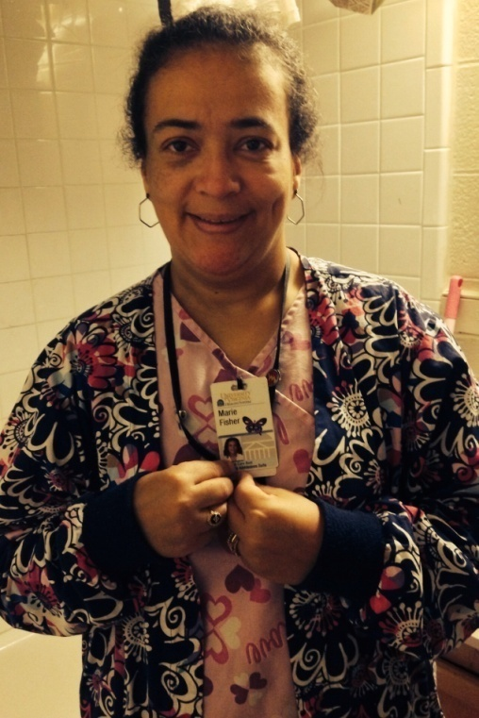
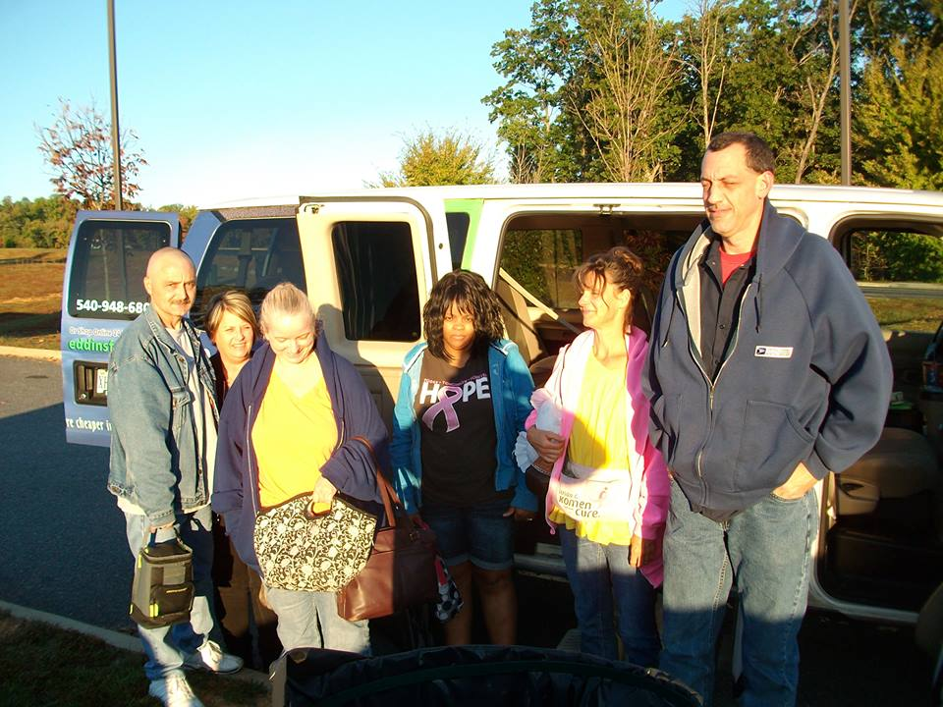
Notes:
Almost 80% of Virginia commuters drive to work alone. In Albemarle it is 77%, in Charlottesville it is 57%.
RideShare Week entries showing different modes to work.
Employers can encourage use of modes other than driving alone to reduce their transportation footprint.

Slide 3
Introduction
RideShare works to help reduce traffic congestion by decreasing the number of single occupant vehicles
A program of the TJPDC
Expanded to CSPDC in 2009
Serves anyone commuting into or out of the TJ Planning District (City of Charlottesville, Counties of Albemarle, Fluvanna, Greene, Louisa, Nelson) and Central Shenandoah Planning District (Counties of Augusta, Bath, Highland, Rockbridge, and Rockingham, and the Cities of Buena Vista, Harrisonburg, Lexington, Staunton, and Waynesboro)

Slide 4
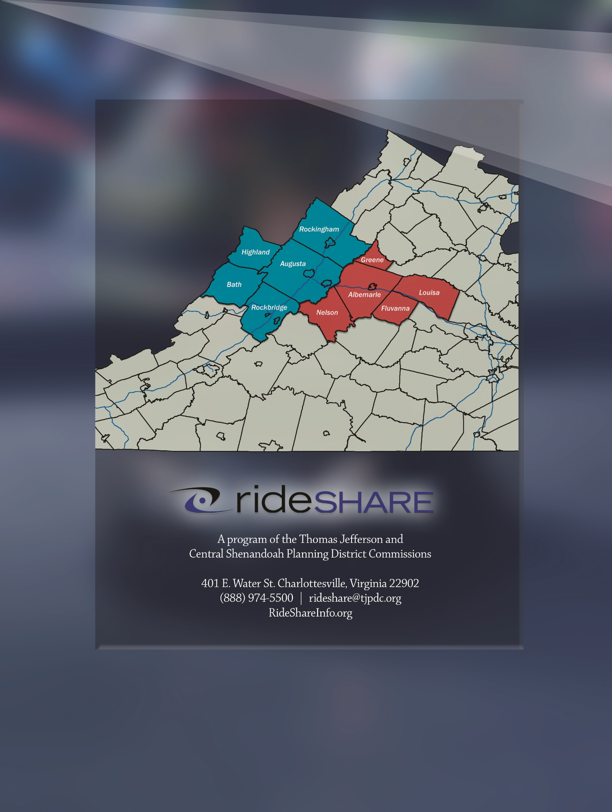
RideShare Coverage Area
CSPDC
TJPDC
Notes:
RideShare was formed in 1980 by JAUNT with a grant from the Virginia Department of Rail and Public Transportation to provide car and vanpool matching services and support. We are now a program of the Thomas Jefferson Planning District Commission and in 2009 expanded our coverage area to include the Central Shenandoah Planning District Commission. We offer free services to all employers in our coverage area and serve commuters that are commuting into our out of the coverage area.

Slide 5
Services
Car/vanpool matching
SchoolPool
Guaranteed Ride Home Program
Park and Ride lot information & marketing
Transportation referral for the region (Commuter Information toll-free number and website)
Employer services

Slide 6
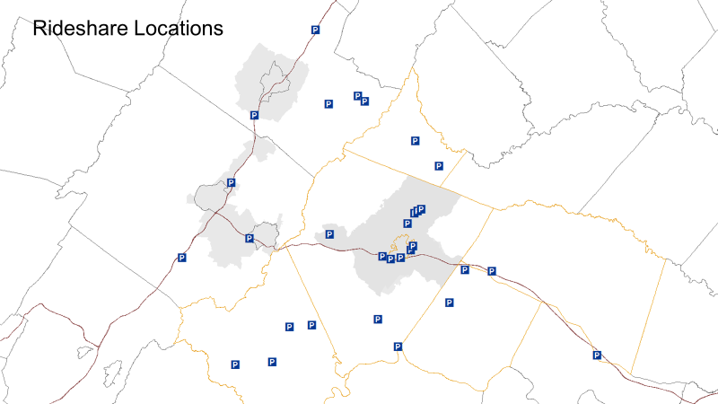

Notes:
Park and Ride lots that are used/managed by the Rideshare program regionally.

Slide 7
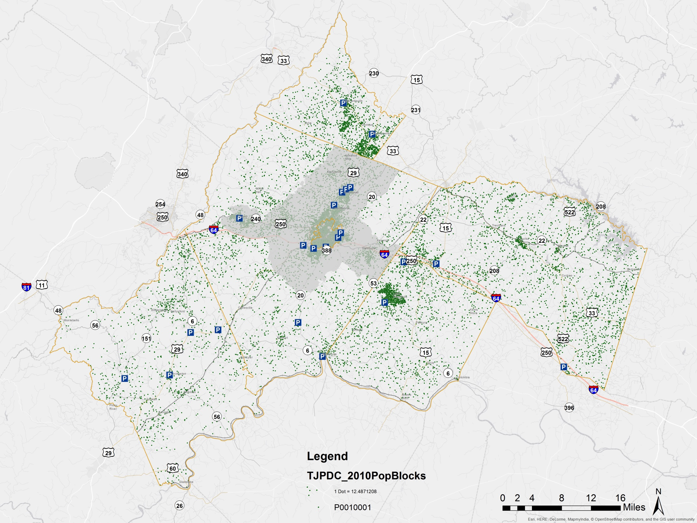
Park & Ride Lots & Pop. Density

Slide 8
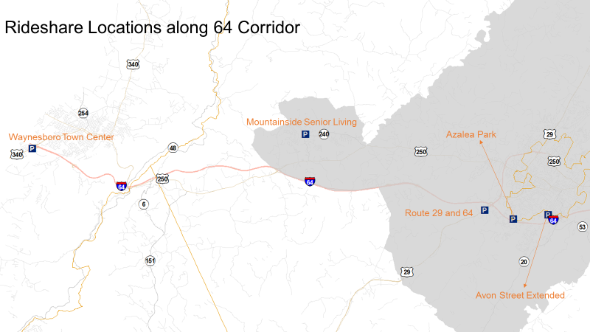

Slide 9
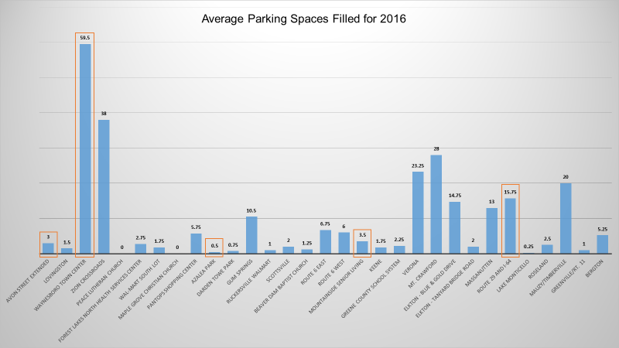
Notes:
This graph shows the average number of parking spaces filled for each park and ride lot in 2016. March, June, September, and December. The ones boxed are park and ride lots along the 64 corridor.
*I just added up the counts for March, June, Sept, and Dec and divided by 4 to get a yearly average.

Slide 10
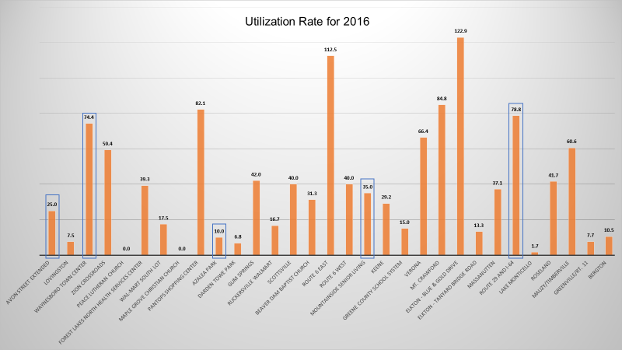
Notes:
This shows the average percentage of spaces filled for each lot in 2016. Boxed locations are along 64 corridor.
*For this one I used the yearly average on the previous slide and divided it by the number of available spots for each lot and multiplied by 100 to get a percentage.

Slide 11
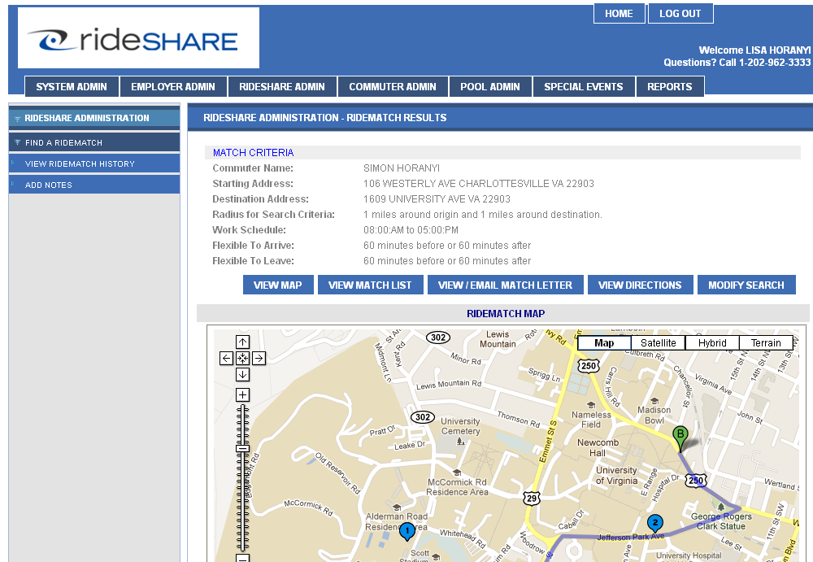
Find a ride match at www.rideshareinfo.org

Slide 12
Use by Locality
Active Data Base Registrants – 518 total
    A - 126, C – 67, F - 42, G - 15, L - 25, N – 11
Waynesboro/Staunton- 80
CSPDC area- 145
Average match rate is 51%
Guaranteed Ride Home Registrants – 175 Total
  A - 31, C – 31, F - 8, G - 10, L - 10, N – 10
If everyone opted to carpool just one day a week, the traffic on the nation’s major highways and roads would be reduced by as much as 20%.

Slide 13
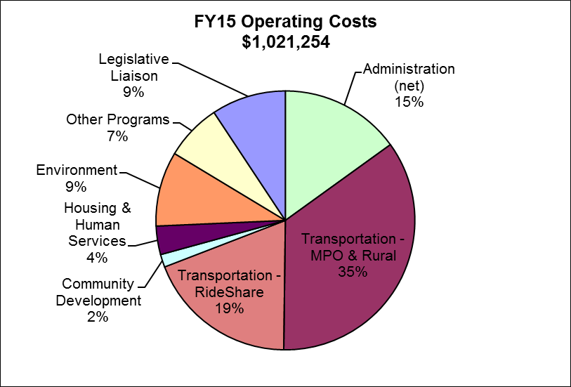
A Major TJPDC Program
RideShare is part of the transportation program, which makes up the majority of TJPDC’s Operating Budget. The RideShare program accounts for 19% of TJPDC operations.
RideShare Funding for FY15
DRPT Grant | $137,200
Charlottesville | $7,013
Albemarle County | $15,892
Fluvanna County | $4,098
Greene County
Louisa County | $5,276
Nelson County | $2,380
Total | $171,859
Grant for FY16 = | $139,258

Slide 14


Thank You!
Please visit www.rideshareinfo.org or contact RideShare for ways to reduce your transportation footprint!

